Slide 1
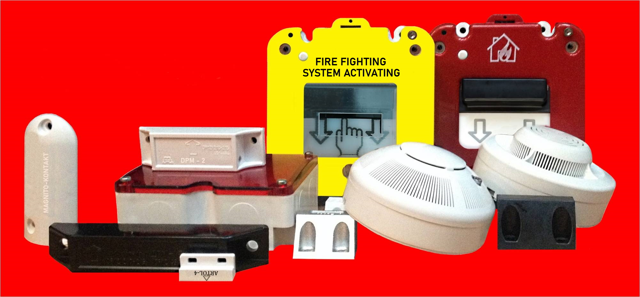
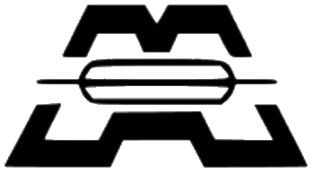
Имя проекта
MAGNITO-KONTAKT
FOR OVER 25 YEARS, THE RESEARCH, DEVELOPMENT, AND PRODUCTION COMPANY
MAGNITO-KONTAKT HAS BEEN IN BUSINESS MANUFACTURING PRODUCTS USED
IN SECURITY AND FIRE ALARM SYSTEMS.
Notes:
Мы разработали этот шаблон так, чтобы у каждого члена группы проекта был набор слайдов с собственной темой. Чтобы добавить новый слайд в набор, сделайте следующее.
Укажите, куда вы хотите добавить слайд. Для этого в области эскизов выберите существующий слайд, нажмите кнопку «Создать слайд», а затем выберите макет.
У нового слайда будет такая же тема, как и у ранее выбранного.
Будьте осторожны! Не раздражайте выступающих неожиданной сменой темы. Это может случиться, если выбрать вариант темы на вкладке макетов. В этом случае изменится оформление всех слайдов в презентации.

Slide 2
PRESENTATION
"MAGNITO-KONTAKT" is the undisputed leader in the production of magnetic
contact detectors in Russia. We have led the industry in the development of
reed detectors and position sensors to advance the state of the art in security
systems. Our burglar and position detectors have been incorporated into most
projects using magnetic detectors since 1996.
Our quality standards are the highest in the industry and our technical
solutions are unambiguous and uncompromising.
For 25 years we have been producing magnetic detectors for burglar alarms,
smoke and heat detectors for fire systems, explosion-proof equipment,
position sensors, etc.

Slide 3
"MAGNITO-KONTAKT" Ltd
The company develops, manufactures and supplies sensors on the base of
reed switches.
The sensors are resistant to external factors, to chemically active media and
dust, workable in a wide range of temperatures, humidity. Sealed electrical
contact provides protection in explosive and fire hazardous environments.
+7(4912)45 16 94 - distribution department 451694@bk.ru
+7(495)320 09 97- sales department 451694@list.ru
+7(4912)47 04 84(1204)-engineering department m-kontakt.com
8 800 350 96 27 (call is free) m-kontakt.ru
51B, place H4, Novaya St., 390027 Ryazan, Russia

Slide 4
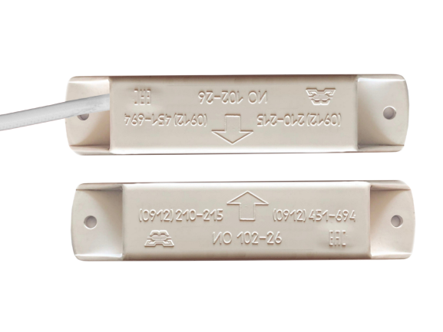
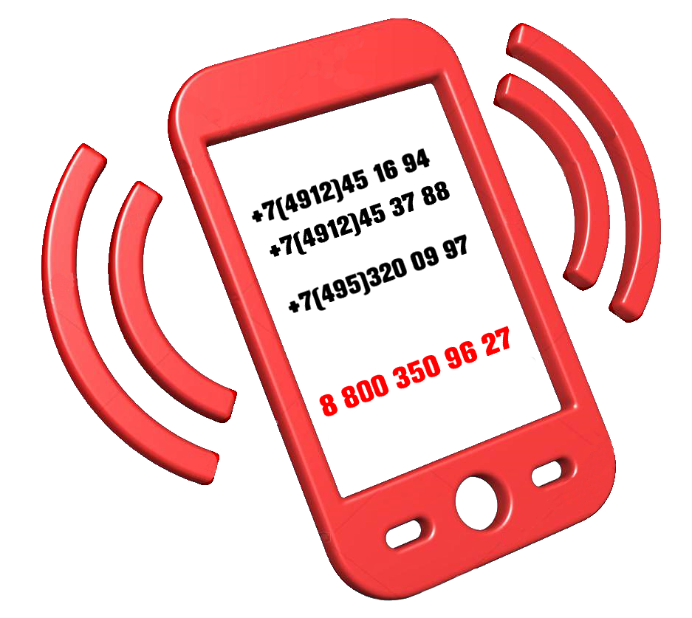
BASE DIRECTIONS
MORE THAN 1000 DEVICES AND THEIR MODIFICATIONS
Detectors for security systems
Position and control sensors for moving structures and objects
Explosion-proof equipment for work in explosive atmospheres
Heat and smoke detectors for fire systems
Switching devices
Liquid level sensors
Metalworking
Mold production
Molding of plastic

Slide 5
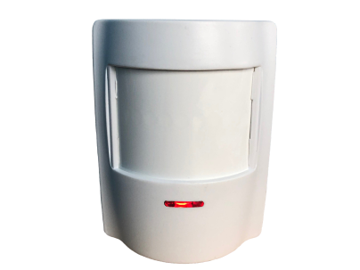
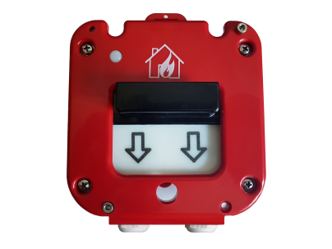
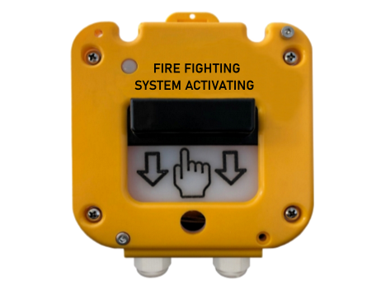
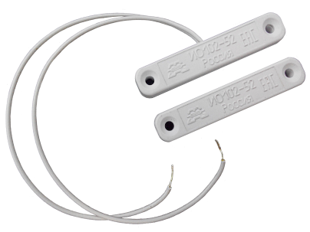
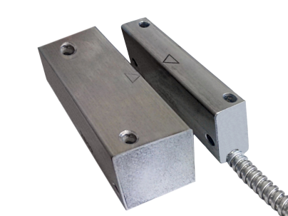
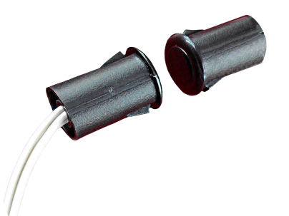
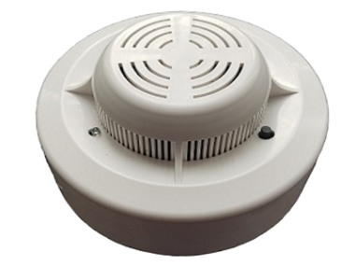
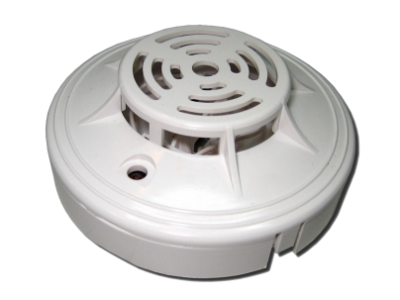
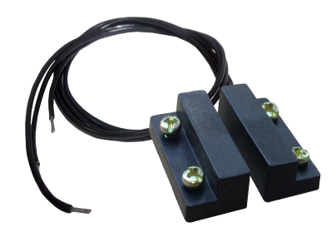
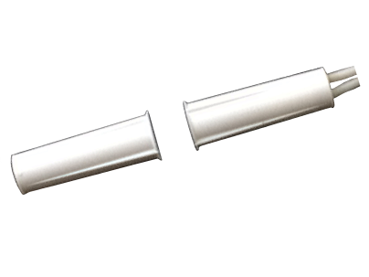
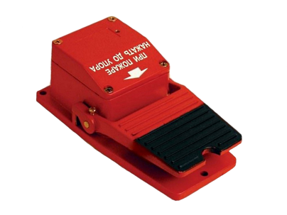
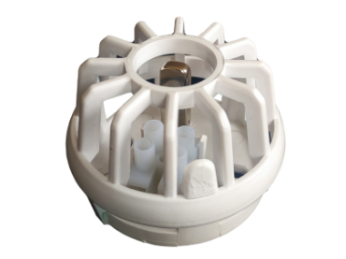
AREAS OF USE
1. SECURITY SYSTEM
2. FIRE ALARM

Slide 6
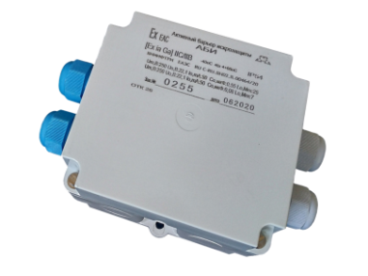
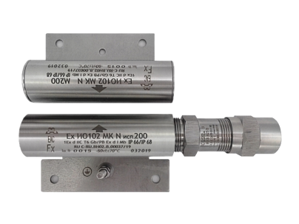
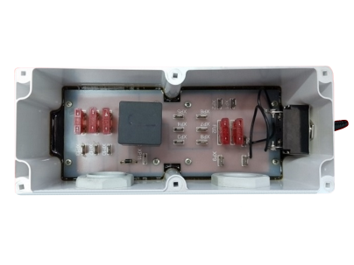
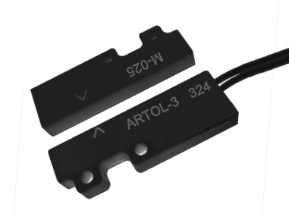
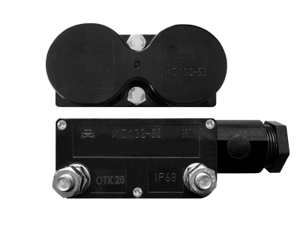
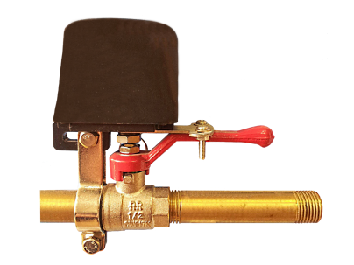
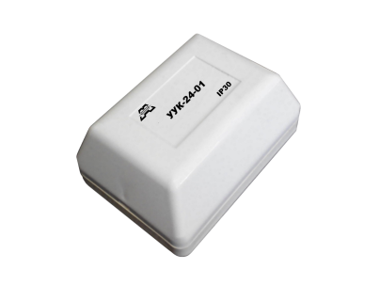
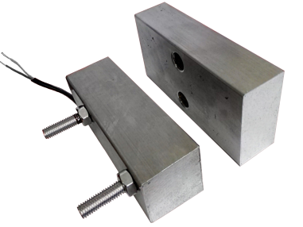
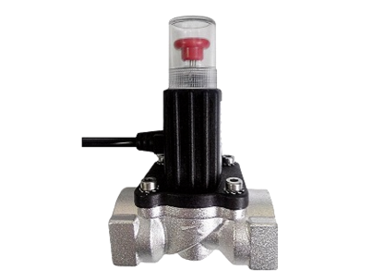
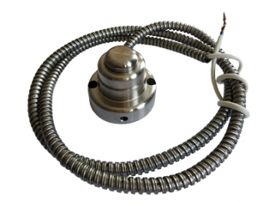
AREAS OF USE
3. EXPLOSIVE AREAS
4. INDUSTRIAL PRODUCTION

Slide 7
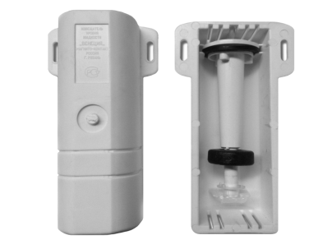
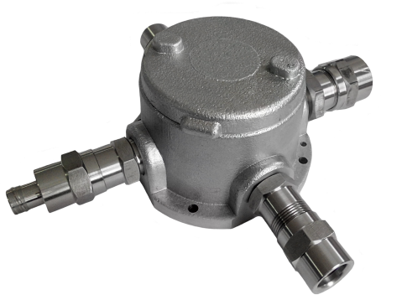
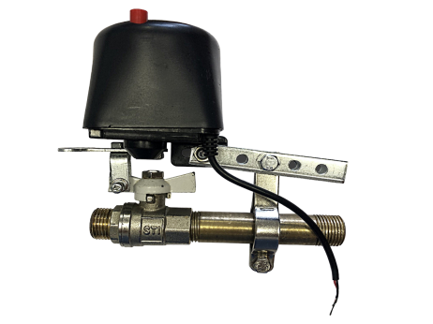
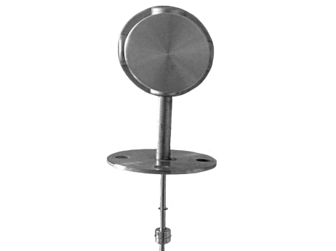
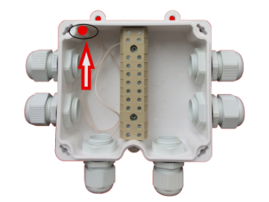
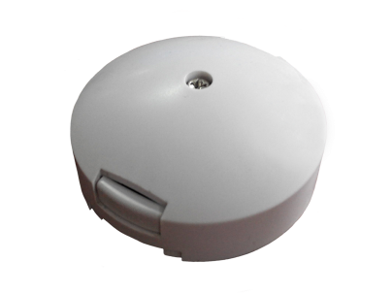
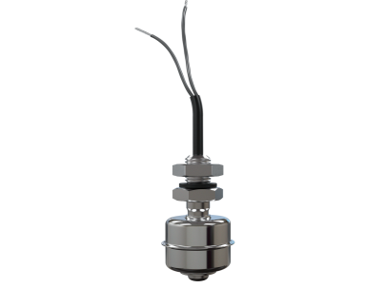
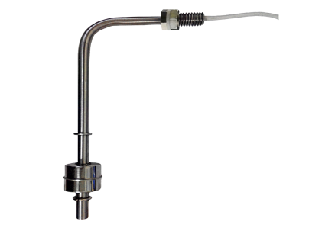
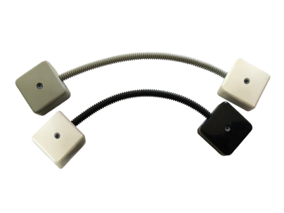
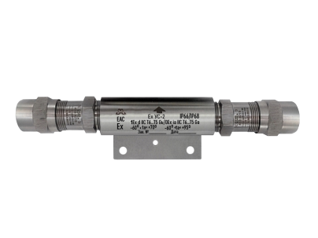
AREAS OF USE
5. SWITCHING DEVICES
6. LIQUID LEVEL SENSORS

Slide 8
OUR ADVANTAGES
Own experimental and experimental workshop.
Full production cycle. The customer receives quality goods at affordable prices.
Development and manufacture of new devices at the request of the consumer. We complete single-piece orders.
Flexible price policy.
Wide range of products.
The company has a certified quality management system.

Slide 9
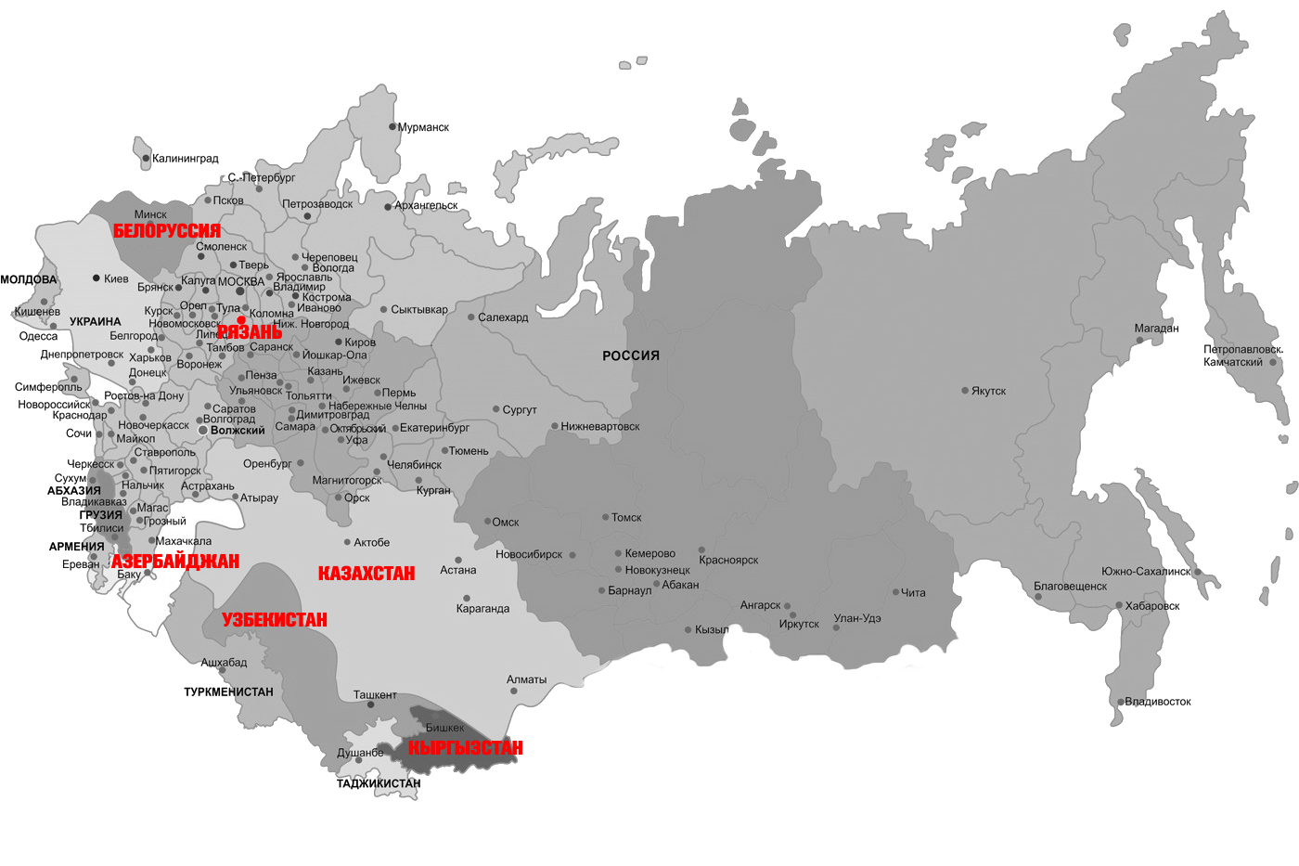
BRANCH MARKET
Devices of the "Magnito-Contact" enterprise successfully operate
throughout the territory of RUSSIA - these are 85 regions of the country
We also cooperate with international market companies.
Today our partners are:
KAZAKHSTAN
BELARUS
UZBEKISTAN
KIRGHIZIA
AZERBAIJAN

